Slide 1
Anomaly Detection using Transformer
By
VISHAL PANDEY
AI/ML Sr. Engineer
Accenture

Slide 2
Problem Statement:
Time Series Anomaly Detection using Transformer
Business Benefit: Ability to detect and forecast the anomalies help reduce the cost of allocation of excess resources and help manage the sudden increase in the demand as well to make the management efficient.

Slide 3
What is Time Series Data?
Time series data is a collection of quantities that are assembled over even intervals in time and ordered chronologically.
The time interval at which data is collected is generally referred to as the time series frequency.
e.g: Electricity consumption data, Stock price data

Slide 4
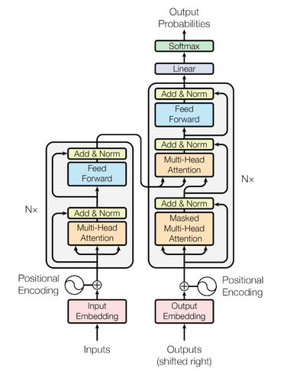
Transformer:
The Transformer in NLP is a novel architecture that aims to solve sequence-to-sequence tasks while handling long-range dependencies with ease.
The Transformer is the first transduction model relying entirely on self-attention to compute representations of its input and output without using sequence-aligned RNNs or convolution.

Slide 5
Data Understanding :
Number of NYC taxi passengers, where the five anomalies occur during the NYC marathon, Thanksgiving, Christmas, New Years day, and a snowstorm. The raw data is from the NYC Taxi and Limousine Commission
The data file included here consists of aggregating the total number of taxi passengers into 30-minute buckets.

Slide 6
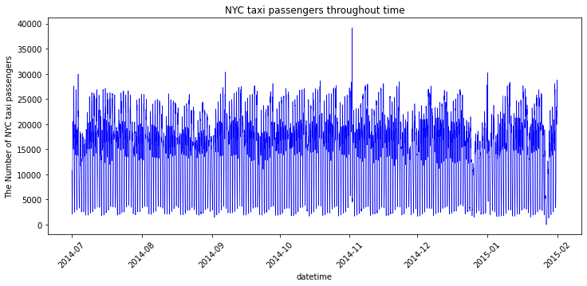
Data Visualization :

Slide 7
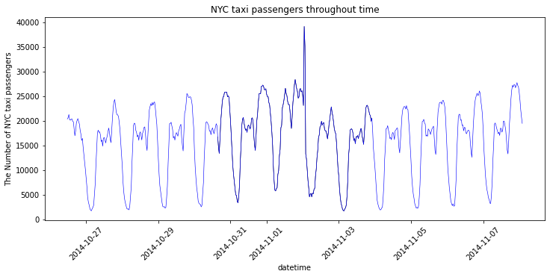
Anomaly Visualization:

Slide 8
Data Preparation:
Steps taken for data preparation:
Reading csv data into a Pandas data frame
Reading annotation data from the respective json file into a dictionary
Scaling the data using Standard Scaler of Sklearn
Creating various features from the data such as- hour, daylight and timestamp for positional encoding, etc - Total of 90 features have been created
Batching the data with a fixed window size
Distributing anomalies across train and test
Creating labels for the respective samples based on whether it is an anomaly or not

Slide 9
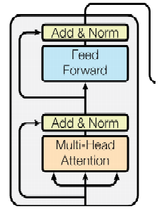
Model Architecture:
Dense
Dense
Input
0/1

Slide 10
Loss Function :
F1 loss:
The F1 score is the harmonic mean of the precision and recall
Binary Cross Entropy Loss:
It measures the accuracy of a model
Total loss:
It is defined as a weighted sum of f1 loss and binary cross entropy loss.

Slide 11
Results:
Accuracy: 11%
F1 – Score: 18%

Slide 12
Conclusion:
Successfully used transformer concept and architecture to model the time series data in order to identify the anomalies in the NYC taxi data.
However, the performance of the model is not acceptable at this point of time as Vanilla architecture Transformer has been used.
More complex transformer architectures in combination with LSTM and bidirectional RNNs can be used to improve performance.
Hyperparameter tuning could also be implemented to improve the model.

Slide 13


